Slide 1
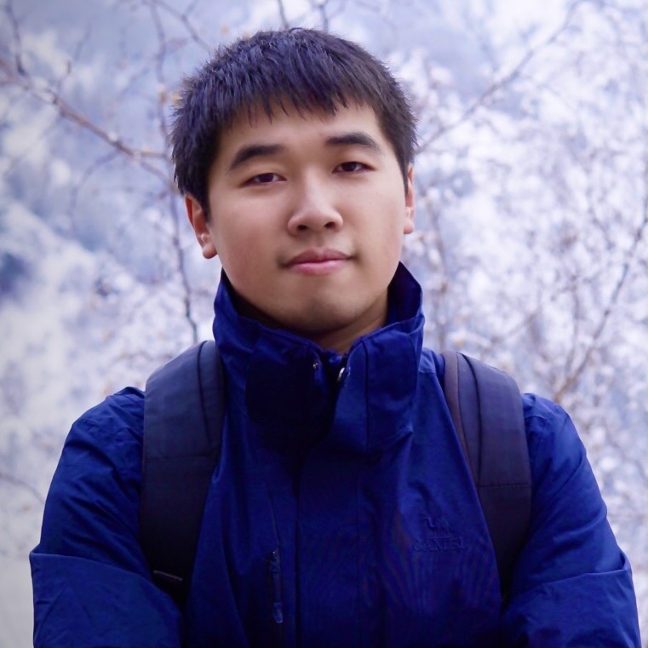

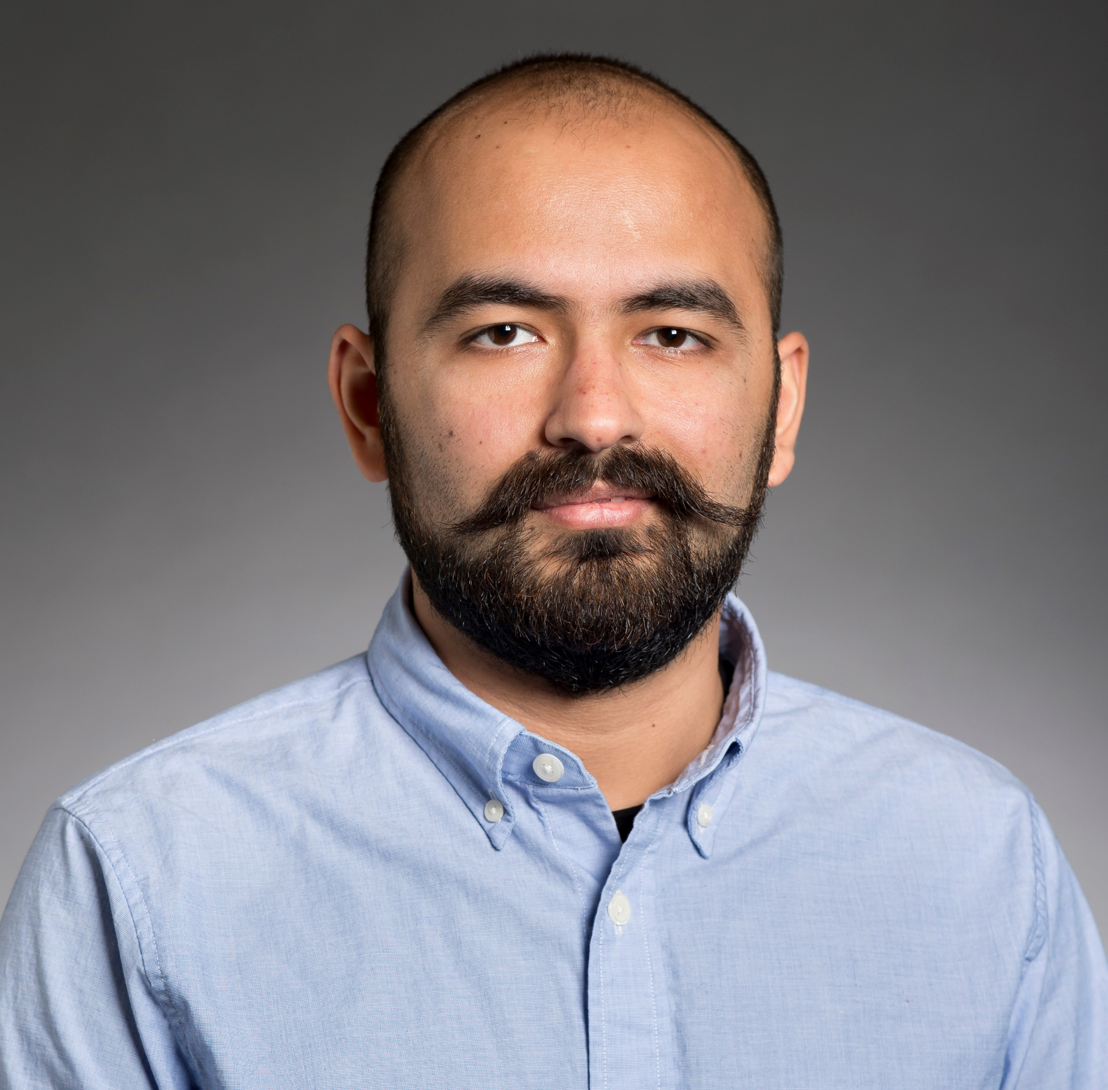
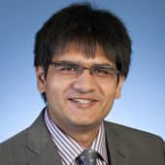
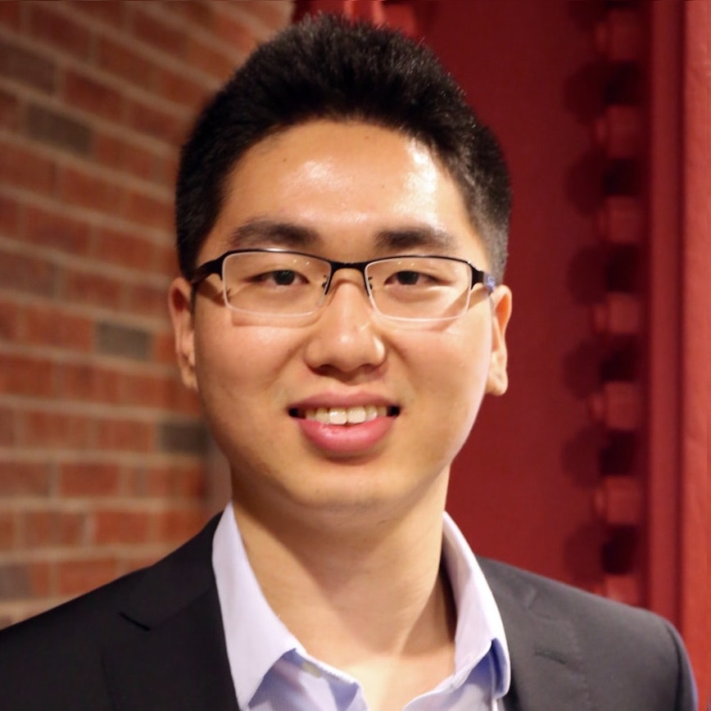
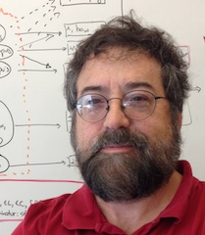



Differentiable Open-Ended Commonsense Reasoning
Bill Yuchen Lin^{1(intern),2} Haitian Sun¹ Bhuwan Dhingra¹ Manzil Zaheer¹ Xiang Ren² William W. Cohen¹
¹
²
2021 Annual Conference of the North American Chapter
of the Association for Computational Linguistics (NAACL 2021)
Notes:
Hi everyone, my name is Yuchen and I am very happy to present our work, differentiable open-ended commonsense reasoning.
This is a joint work by google research and USC. I was a summer intern at Google and I am now a phd candidate at USC.

Slide 2
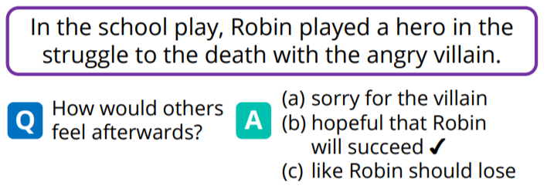
Common-Sense Reasoning (CSR)
The common knowledge that is shared among most people in the world.
The reasoning ability to make decisions in everyday life.
CSR as Multiple-Choice Question Answering (QA)
Where do adults use glue sticks?
A: classroom B: office (√) C: desk drawer D: store
CommonsenseQA (Talmor et al. 2019)
Social IQA (Sap et al. 2019)
Notes:
In this work, we study commonsense reasoning.
It is a human-like ability to use common knowledge that is shared by most of the people in the world
to reason and make decisions in everyday life.
Most of the prior works have focused on learning models with common sense to solve multiple-choice question answering tasks,
such as CommonsenseQA and Social IQA.

Slide 3



Is multiple-choice QA realistic?
Search Engines
Dialogue Systems
Robots
Common Sense as a Service for practical AI applications.
Real use cases usually do NOT provide answer candidates for querying common sense.
Notes:
Well, are multiple-choice QA useful in realistic applications?
When we develop smart search engines, dialogue systems, and robots,
real use cases usually do not provide any answer candidates for commonsense knowledge.
To make Common Sense as a Service for practical AI applications, we would like to go a step forward.

Slide 4

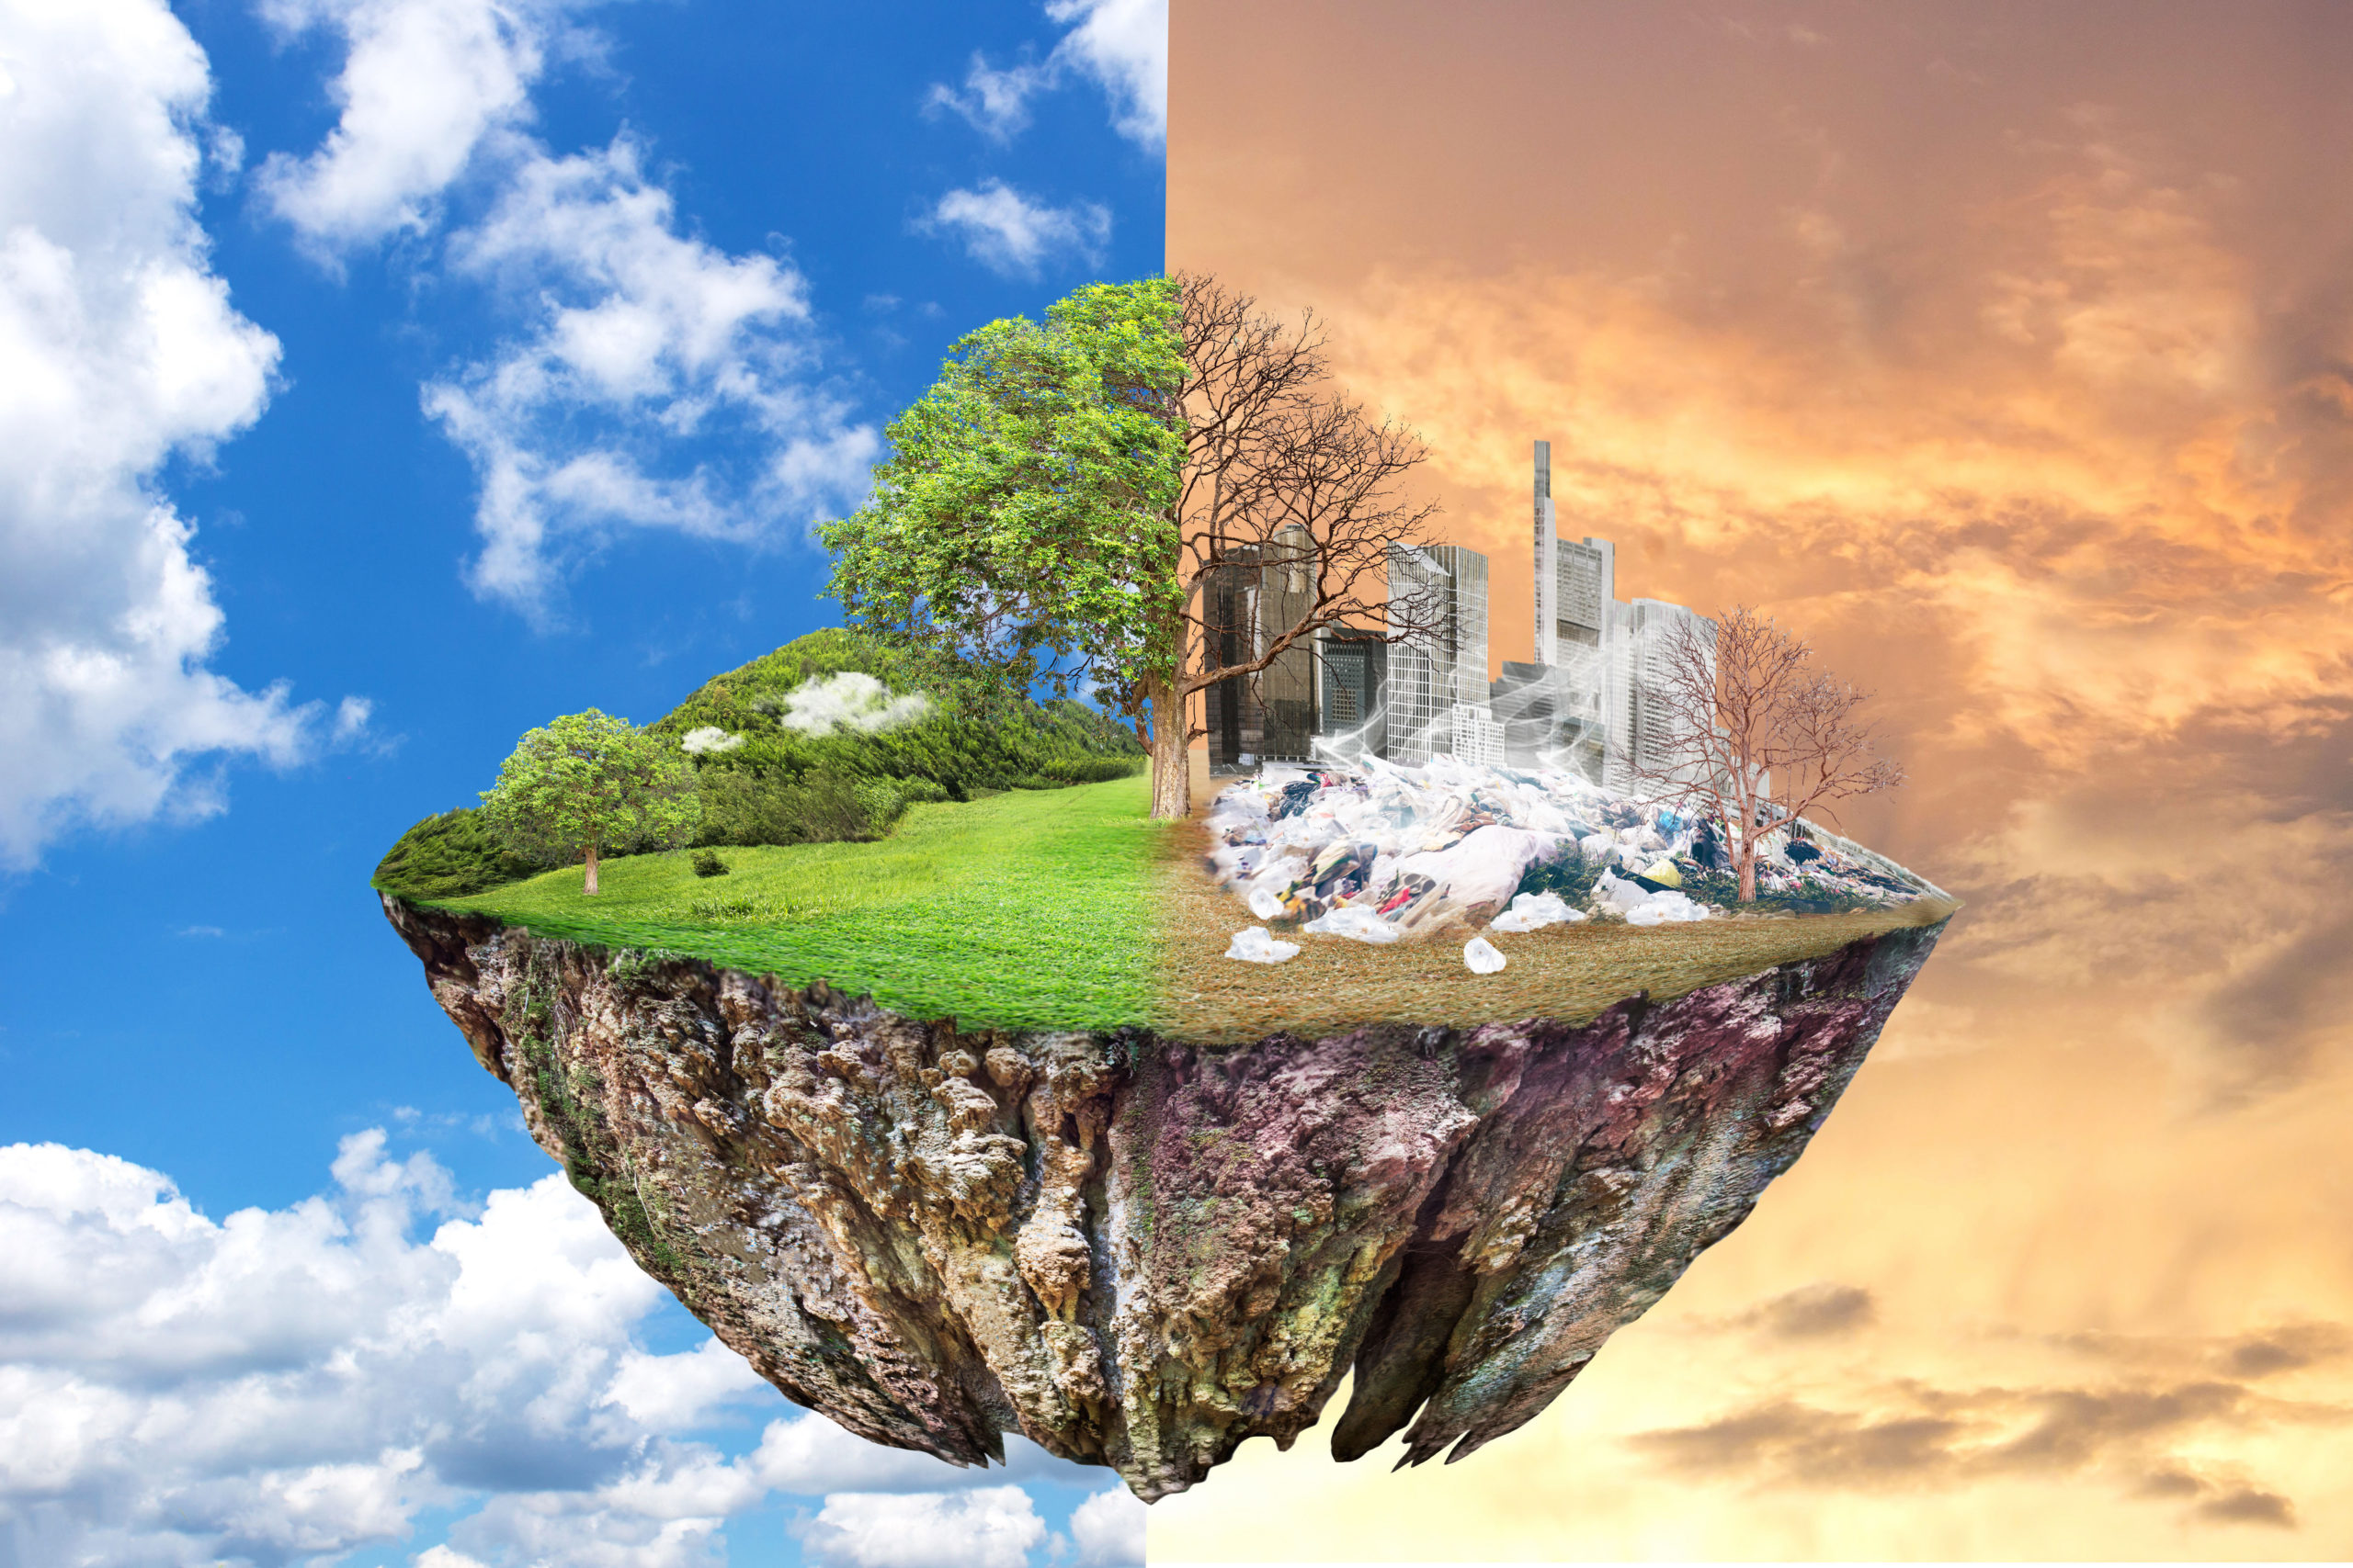


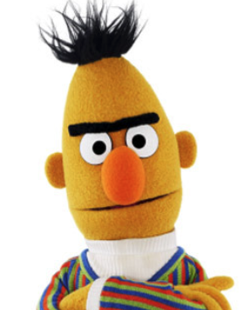
Our Proposal: Open-Ended Commonsense Reasoning
Q: What can help alleviate global warming?
Multiple-Choice/Closed CSR
Input: a question + a few choices
Open-Ended CSR
Input: a question only
A) air conditioner B) fossil fuel
C) renewable energy D) carbon dioxide
A large text corpus of commonsense facts
Carbon dioxide is the major greenhouse gas contributing to global warming .
Trees remove carbon dioxide from the atmosphere through photosynthesis .
?
renewable energy, tree, solar battery, …
Can machines learn to reason without answer candidates?
Output:
a ranked list of concepts as answers.
Notes:
Therefore, we propose to Open-Ended CSR.
For example, given a question like “what can help alleviate global warming?”, the conventional formulation would consider input as a set of pre-defined choices like these. The job of models is thus to find the most plausible one as the answer.
On the contrary, we proposed Open-Ended CSR, which only uses the question itself as the input. And the output will be a ranked list of concepts as the answers to the input question.
This is possible if we have a large text corpus of commonsense facts which contains facts such as 1. and 2.
Because these two facts together can tell us “tree” is an acceptable answer to the question, and we believe other useful combinations of facts can arrive at other correct answers.
Therefore, our focus in this paper is how we can teach machines to reason in such a way to answer open-ended commonsense questions!

Slide 5
Why is OpenCSR challenging?
1) Latent Multi-Hop Structures (vs. factoid questions).
Who voices the dog in
the TV show Family Guy ?
q₁= the dog in the TV show Family Guy
q₂= who voices [q₁. answer]
A multi-hop, factoid question from HotpotQA.
Clear, explicit hints for querying
evident relations between named entities.
What can help alleviate global warming?
q₁= what contributes to global warming
q₂= what removes [q₁. answer]
Latent, implicit hints for querying complex relations between concepts.
2) Very Large Search Space (vs. multiple-choice setting).
3) Much Denser Entity Links (vs. named entities).
Notes:
Let’s look at why OpenCSR is particularly challenging.
The first reason is that commonsense questions usually imply latent multi-hop structures (versus factoid questions).
For example, a multi-hop, factoid question from HotpotQA might ask “Who voices the dog in the TV show Family Guy ?“, which models can easily reason about by decomposing it to q1 and q2 here. This is due to the clear and explicit hints in the question itself.
However, for the commonsense question that “what can help alleviate global warming”, the decomposition is more latent and implicit: we need to know what contributes to global warming and then what removes that. this is more implicit End it is harder to infer that from the question itself.
Apart from this, there are two other challenges such as very large search space (versus multiple-choice setting) and much denser entity links (versus named entities).

Slide 6
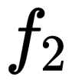
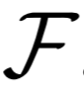
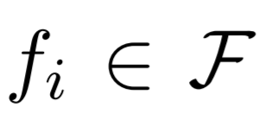
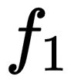
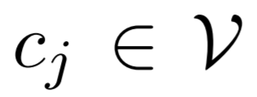
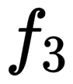

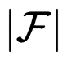
Notations for DrFact
a corpus of common-sense facts, e.g., GenericsKB.
= trees remove carbon dioxide from the atmosphere through photosynthesis .
= carbon dioxide is the major greenhouse gas contributing to global warming .
photosynthesis
tree
A fact is a sentence of generic commonsense knowledge
global warming
carbon dioxide
A knowledge corpus as a hypergraph.
atmosphere
greenhouse gas
A concept is a noun or noun-chunk that are mentioned in asd
water
oxygen
= the atmosphere contains oxygen, carbon dioxide, and water.
A weighted set of facts →
A sparse vector.
Dense Matrix
of Fact Embeddings
Sparse Matrix
of Concept-to-Fact Links
Sparse Matrix
of Fact-to-Fact Links
Notes:
To address the above challenges, we propose a fact-based formulation of the multi-hop commonsense reasoning problem. And the name of our model is DrFact.
I am going to first introduce some mathematical notations and then present our approach.
We assume that we have a knowledge corpus consisting of commonsense facts, where each fact f_i is a sentence of generic commonsense knowledge.
There are some concrete examples on the right-hand side. You can f1 mentions three concepts. Cd gw, gg, Similarly, we have f2 and f3 here. Each concept here is a node and each fact instead is a hyper-edge that connects multiple nodes. Therefore, we can view the knowledge corpus as a hypergraph.
To encode and index the whole knowledge corpus with such a hypergraph formulation, we use three pre-computed matrixes.
First, we compute a Dense Matrix of Fact embeddings, using BERT in a bi-encoder model similar to the recent DPR.
Then, the concept-to-fact links are encoded as a sparse matrix, so we can easily know what concepts are mentioned by a fact.
Finally, we build a fact-to-fact sparse matrix here to encode the links between facts that share common concepts.
Note that we use a sparse vector to represent a weighted set of facts, where each element is a scalar between 0 and 1 to represent the weight of a fact.

Slide 7
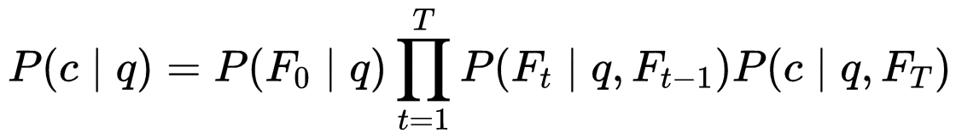
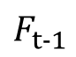
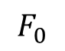
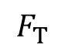
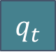
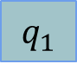
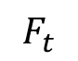
Overall Workflow of DrFact
q: What can help alleviate global warming?
Question Encoder
Hop-1 Qry Emb
Hop-2 Qry Emb
...
Shared Qry Emb
Concept Re-ranker
(Optional)
$$F_{0}$$
$$F_{t−1}$$
$$F_{t}$$
$$F_{T}$$
q
Fact Index
$$q_{1}$$
$$q_{t}$$
….
tree
Get Initial Facts
Fact-to-Concept
Question
Concepts
Initial Facts
Hop-1
Facts
Hop-2
Facts
Final-Hop
Facts
Concept-to-Fact
Notes:
Now I’m presenting the overall workflow of our DrFact model.
Given a question here, we use BERT as the question encoder to get its representations. A shared query embedding and multiple hop-wise embeddings.
We construct the initial facts using both the fact index and concept-to-fact matrix. The initial facts F_0 here are sentences that are relevant to the question and also linked by question concepts.
We then repeat the fact-follow operations to go from a set of facts F_{t-1} to another set of facts F_t, given a hop-specific query embedding q_t.
Finally, we find the concepts by Fact-to-Concept matrix and then rank them for answers.
This process can be seen as modeling the probability of concept c as the answer to the question q by three steps:
1) get the initial facts, 2) T-times fact-follow, and 3) concept scoring.
We can use an optional concept-reranker to further improve the results.
So, as you can see, the most important module here is the Fact-Follow operation.

Slide 8
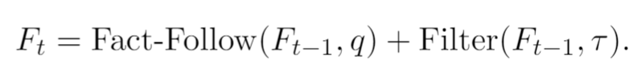
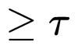
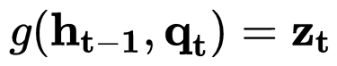

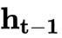
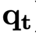
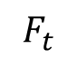
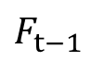
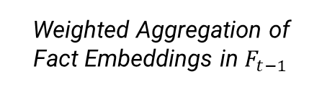
DrFact: Differentiable Fact-Following Operation
Self-Following
$$F_{t−1}$$
$$F_{t}$$
Sparse Fact-to-Fact Matrix
Sparse-Dense
Mixing
Sparse Retrieval as Filtering
Input:
Previous-Hop
Output:
Next-Hop
MIPS
Dense
Retrieval
Dense Fact Index
Dense Fact Index
Weighted Aggregation of Fact Embeddings in $F_{t−1}$
Question Embedding at Hop-t
Notes:
Our major contribution is to implement an efficient and differentiable fact-following operation to support the previous formulation of reasoning.
Given the weighted set of facts from the previous hop, we have two threads of retrieval.
The first one is based on the dense fact index. We first use the fact index to get a dense vector representation of the set of facts, and then combine it with the hop-specific query vector to build a query for fact index via MIPS search.
These dense-only retrieval method is very likely to produce noisy results. Therefore, we use our sparse fact-to-fact matrix to filter the dense-retrieved facts that that do not share common concepts with the previous-hop facts.
We also add a self-following trick which can reuse the important facts to improve the flexibility and the memory of the models, making the model more flexible for questions of different hops.

Slide 9
Comparisions with baseline methods.
Methods | BM25 （off-the-shelf） | DPR （EMNLP 2020） | DrKIT (ICLR 2020) | DrFact (NAACL 2021)
Knowledge Structure | A set of documents | A set of documents | Mention-Entity Bipartite Graph | Concept-Fact Hypergraph
Multi-hop Reasoning Formulation | N/A | N/A | Entity-Following | Fact-Following
Index for Dense Retrieval | N/A | Dense Fact Embeddings | Dense Mention Embedding | Dense Fact Embeddings
Sparse Retrieval Method | TF-IDF based Index+ BM25 Ranking Func. | N/A | Entity Cooccurrence | Fact-to-Fact Matrix
Multi-Hop Questions | N/A | N/A | Aggregating Multiple Models | A single model w/ Self-Following
Intermediate Supervision | N/A | N/A | N/A | Distant Supervision
Notes:
Here we present the comparisons between DrFact and other methods to open-retrieval QA in different dimensions.
BM25 is an unsupervised method using sparse features, and DPR is a dense embedding-based method. Both of them are not suitable for multi-hop reasoning and model the corpus as a unstructured set of documents.
DrKIT is the most similar work to ours but it focuses on entities and mentions, which is thus inefficient in our case because concepts are much more densely connected than named entities. Also, using mention embeddings makes it lose the information of full facts.

Slide 10
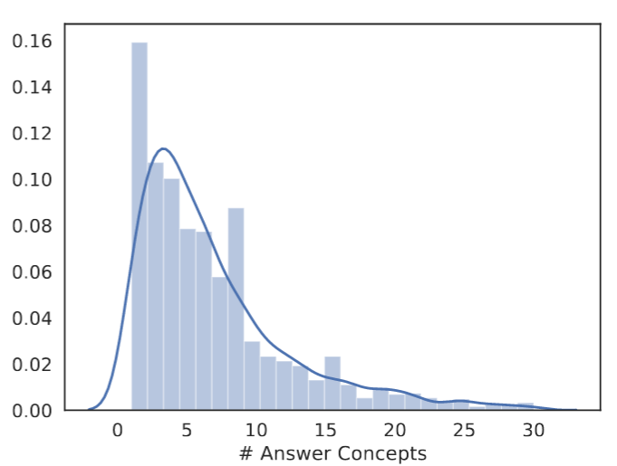
Evaluation Setup
OpenCSR Dataset
Reformatted 3 Multiple-Choice QA Datasets (ARC, OBQA, QASC)
+ Human-Annotated Answers (7 answer concepts per question on average)
Metrics for evaluation
Hit Acc @ K <-- In the top K retrieved facts, there is at least one fact containing a correct answer (1 or 0).
Ret Acc @ K <-- In the top K retrieved facts, the percentage of the recalled answer concepts (over all the correct answer concepts).
Both are reported as an average over all examples in the test set.
Notes:
To evaluate different methods,
we reformatted three existing multiple-choice QA datasets, and also collected additional acceptable answers for each test example (resulting 7 answer concepts per question on average).
The metric we used here are hit acc @ k and ret Acc @ k. One focuses on the precision and the other emphasize the recalling ability.

Slide 11
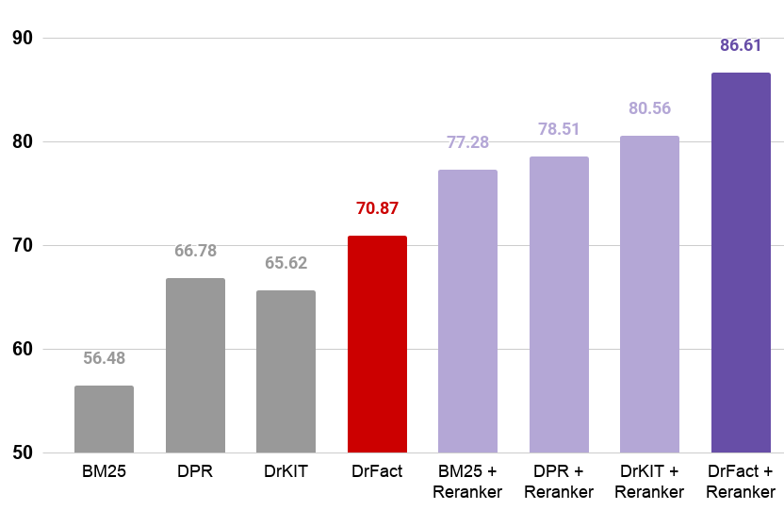
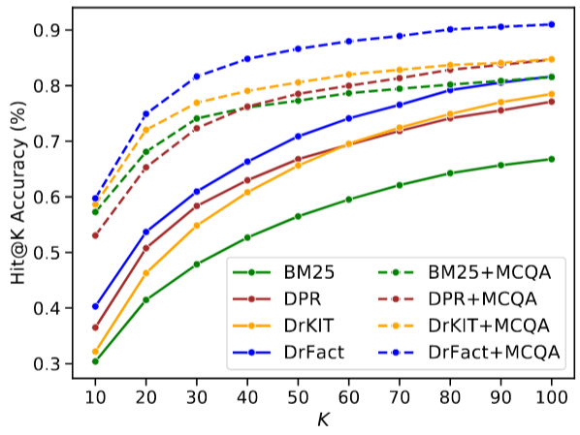
Main Experimental Results
Hit Acc @50
Notes:
Here we only report the hit accuracy at different K and please find more results in our paper.
This is the hit@k accuracy results when K=50 of the four methods with and without concept-reranking.
our DrFact has a significant improvement over the other methods
We can see here the curves for different K and the gap is becoming larger when K increases.

Slide 12
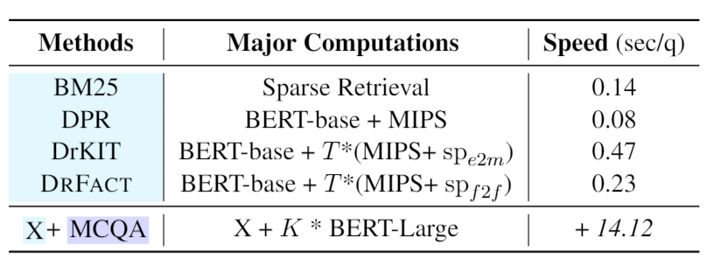
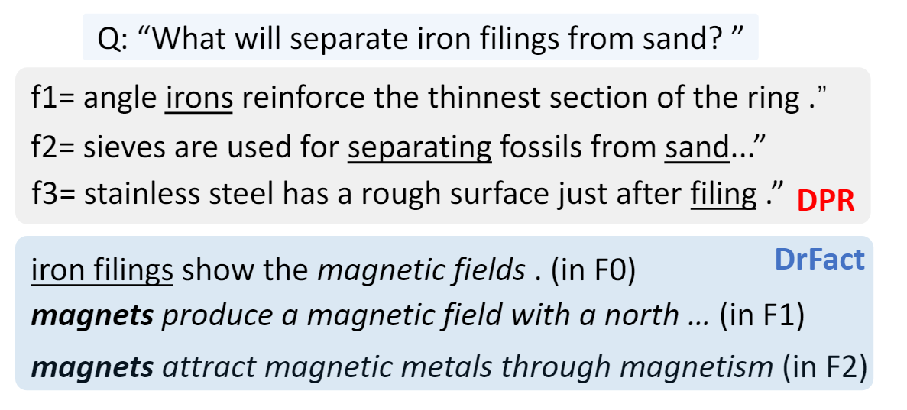
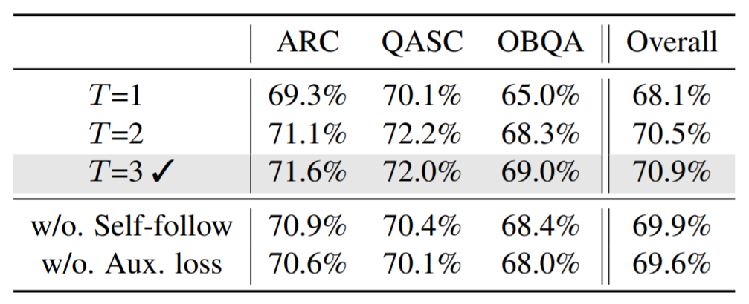
Experimental Results
DPR vs DrFact:
Faithfulness and Interpretability
Notes:
We report the efficiency and ablation studies here, showing the efficiency and effectiveness of our method.
On the right-hand side, we can see a case study for comparing the results by DPR and DrFact.
Our DrFact can better understand the question by multi-hop reasoning thanks to the dense-sparse retrieval.
But the DPR method is misled by the noisy results caused by reporting bias.

Slide 13
Findings and Take-Home Messages
OpenCSR is a novel setting to study CSR
more realistic and challenging．
new data annotation for evaluation.
DrFact is an effective and efficient method for OpenCSR.
differentiable Fact-Follow operation for end-to-end learning.
state-of-the-art performance comparing to strong baselines.
improve the explanations for multi-hop questions.
Our project website is https://open-csr.github.io

